Slide 1


SIMATS ENGINEERING
SAVEETHA INSTITUTE OF MEDICAL AND TECHNICAL SCIENCES
CHENNAI-602105
CAPSTONE PROJECT PRESENTATION
IoT-BASED SMART GRID POWER QUALITY MONITOR
Pharmacy Critical-Load Power Quality Monitoring using ESP32
ECA0501-Engineering Electromagnetics
SUPERVISED BY:
PRESENTED BY:
Dr .Joselin Jeya Sheela J
Konjeti Pavan Deekshith-192412172
Kalavakunta Karthik Arjun-192412650
K Kodandaram-192312565

Slide 2
Introduction
Unstable Grid Reality: Voltage sags, surges, and overcurrent events are common on shared or weak grid connections and often go unnoticed until equipment fails.
Critical-Load Exposure: Small businesses and pharmacies run temperature-sensitive equipment (fridges, POS systems) directly off unmonitored mains supply.
IoT-Enabled Awareness: This project implements an ESP32-based monitor that continuously senses voltage and current, displays live status locally, and pushes real-time alerts to a cloud dashboard so staff can act before damage occurs.
2

Slide 3
Objective
Real-Time Sensing: Continuously measure line voltage (ZMPT101B) and load current (ACS712) using an ESP32 microcontroller.
Fault Detection Logic: Program threshold-based detection for voltage sag, voltage surge, and overcurrent conditions.
Local + Remote Visibility: Display live readings on an OLED screen and stream data to an Adafruit IO dashboard over Wi-Fi.
Actionable Alerts: Notify staff instantly of abnormal conditions so they can switch to backup power or unplug critical loads.
3

Slide 4
Problem Statement
Silent Failures: Voltage sags and surges on unstable supply lines damage compressors and electronics gradually, with no warning to staff until the fridge or equipment stops working.
Spoilage Risk: Pharmacies storing temperature-sensitive medicines and vaccines risk major financial and public-health loss if a power event goes unnoticed for even a few hours.
No Remote Insight: Standard mains connections give no live, remote visibility into power quality - staff only discover a problem after the damage is already done.
4

Slide 5
Literature Surveys
Author / Year
Method / Technology Used
Key Contribution
Limitations
Kavitha & Rao, 2020
ESP32-Based IoT Power Monitor
Enabled real-time voltage & current monitoring with cloud dashboards
Accuracy affected by low-cost sensor calibration drift
Patel et al., 2019
ACS712 / ZMPT101B Sensing
Demonstrated low-cost, non-invasive voltage & current sensing for embedded systems
Limited to single-phase, small-load applications
Zhou & Lee, 2021
Smart Grid Power Quality Analytics
Improved detection of voltage sag/surge events using threshold-based algorithms
Needs large datasets to fine-tune thresholds for varied loads
Reddy & Sharma, 2022
IoT Cold-Chain Monitoring (Adafruit IO)
Enabled remote alerts for medical refrigeration to prevent vaccine spoilage
Dependent on stable Wi-Fi connectivity for real-time alerts
Fernandes et al., 2018
Relay-Based Load Protection Systems
Automated disconnection of loads during unsafe voltage conditions
Added hardware cost and risk of nuisance tripping
5

Slide 6
Module 1: Sensing and Data Acquisition
Voltage Sensing (ZMPT101B): Steps down and isolates the AC mains voltage into a safe analog signal the ESP32's ADC can read, forming the basis for RMS voltage calculation.
Current Sensing (ACS712 / SCT-013): Uses the Hall-effect / current-transformer principle to convert load current into a proportional analog voltage without breaking the circuit.
Signal Sampling: The ESP32 samples both analog channels at high frequency and computes RMS voltage, RMS current, real power, and power factor in real time.
Safe Test Environment: A low-voltage transformer and switchable load bank simulate mains behavior on the bench, allowing safe, repeatable fault demonstrations.
V
Voltage Sensor (ZMPT101B)
I
Current Sensor (ACS712)
6

Slide 7
Module 2: Processing, Display and Threshold Logic
Feature Extraction: The ESP32 (core controller) converts raw ADC samples into calibrated RMS voltage, current, power, and power factor values every sampling cycle.
Threshold Classification: Live readings are compared against safe operating limits (e.g., below 207V = Sag, above 253V = Surge, above 5A = Overcurrent) to classify system status.
OLED Status Display: The classified status (Normal / Sag / Surge / Overcurrent) plus live V, I, P, and PF values are shown locally on the OLED for on-site staff.
ESP32
ESP32 Microcontroller
OLED Display
7

Slide 8
Module 3: Connectivity and Remote Alerts
Wi-Fi Connectivity: The ESP32's built-in Wi-Fi pushes live sensor data to the cloud at regular intervals without any additional networking hardware.
Adafruit IO Dashboard: Voltage, current, power, and status feeds are visualized on a live dashboard, giving managers remote, real-time visibility into the load's health.
Instant Alerts: The moment a sag, surge, or overcurrent event is detected, an alert is pushed to the dashboard so staff can take immediate action - switch to backup power, unplug the load, or call a technician.
Wi-Fi Connectivity
!
Adafruit IO + Alerts
8

Slide 9
Block Diagram
Input (AC Mains) → Sensing → Signal Conditioning → Processing / Threshold Comparison → Local Display and Remote Cloud Alert
AC MAINS
SUPPLY
VOLTAGE &
CURRENT SENSORS
SIGNAL
CONDITIONING
ESP32
(PROCESSING &
THRESHOLD LOGIC)
OLED DISPLAY
(LOCAL STATUS)
WI-FI → ADAFRUIT IO
(REMOTE ALERT)
The system continuously repeats this sensing → processing → alerting cycle in real time.
9

Slide 10
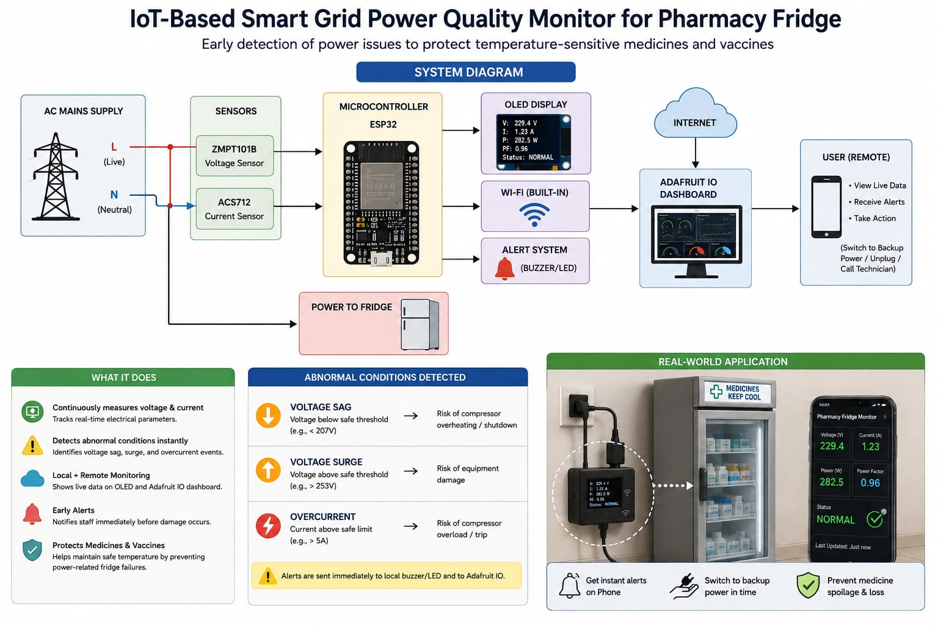
System Architecture
10

Slide 11
Real-World Application
Deployment Scenario: Placed on the power line feeding a pharmacy's medicine/vaccine fridge, the unit continuously watches voltage and current.
Instant Alerts: Real-time notification the moment power quality degrades - no more discovering a spoiled fridge hours later.
Faster Response: Staff can switch to backup power or unplug sensitive equipment within minutes of receiving an alert on their phone via Adafruit IO.
Reduced Loss: Protects temperature-sensitive medicines and vaccines from spoilage caused by unnoticed power events.
11

Slide 12
Results & Discussion
Accurate Sensing: Bench testing with a low-voltage transformer and switchable loads confirmed the ESP32 correctly computed RMS voltage and current within acceptable tolerance.
Reliable Fault Detection: Simulated sag, surge, and overcurrent events were correctly classified and reflected on the OLED and Adafruit IO dashboard within seconds.
Effective Remote Alerting: Alerts pushed to the dashboard were visible on a mobile device in real time, validating the local and remote monitoring concept.
12

Slide 13
Future Scope
Auto Protection Relay: Add a relay module to automatically disconnect the load during severe faults, reducing dependence on manual staff response.
SD Card Data Logging: Add local storage for long-term power quality history, useful for grid-reliability reporting to utility providers.
Multi-Node Deployment: Scale to multiple units across a facility or multiple pharmacy branches, all reporting to one central dashboard.
Predictive Alerts: Apply simple trend analysis to warn staff before a fault fully develops, not just after it occurs.
13

Slide 14
Conclusion
Objective Achieved: A working IoT-based power quality monitor was designed and implemented using an ESP32, voltage/current sensors, and an OLED display.
Validated Detection: The system successfully detected simulated voltage sag, surge, and overcurrent conditions and reflected them locally and on a cloud dashboard.
Real-World Relevance: Applied to a pharmacy critical-load scenario, the system demonstrates a low-cost, practical way to protect temperature-sensitive medicines from power-related damage.
14

Slide 15
References
Kavitha, S., & Rao, P. (2020). IoT-Based Real-Time Power Quality Monitoring Using ESP32. International Journal of Embedded Systems.
Patel, R., & Mehta, A. (2019). Low-Cost Voltage and Current Sensing for Embedded Power Monitors. IEEE International Conference on Smart Systems.
Zhou, Y., & Lee, H. (2021). Smart Grid Power Quality Analytics for Voltage Sag and Surge Detection. Journal of Power and Energy Engineering.
Reddy, K., & Sharma, N. (2022). IoT-Based Cold-Chain Monitoring for Vaccine Storage. International Journal of Advanced Research in Electronics and Communication Engineering.
Fernandes, J., & Silva, M. (2018). Relay-Based Automatic Load Protection Systems for Unstable Grid Conditions. Journal of Control and Automation Engineering.
15

Slide 16
THANK YOU
Questions & Discussion

